Slide 1
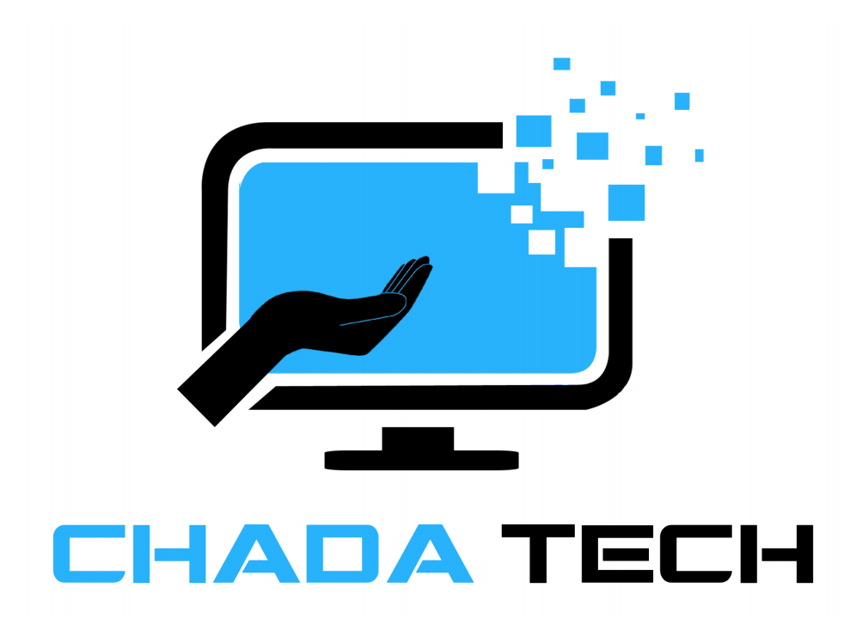

Pedro Martinez
Scrum Master

Slide 2

Agile Roles Explained
Product owner
Communicates with the stakeholder, clients and the scrum master, transparent with everyone, helps with the backlogs when needed
Scrum Master
Helps runs the operations, works and collaborates with everyone, creates back logs and utilizes methods like sprint planning and daily scrums
Developer
Creates a product based on the client's information, adapts to any changes that the product owner suggests, write user stories about what its doing
Tester
Test to see if everything is running smooth, sees if everything is working like its suppose to

Slide 3
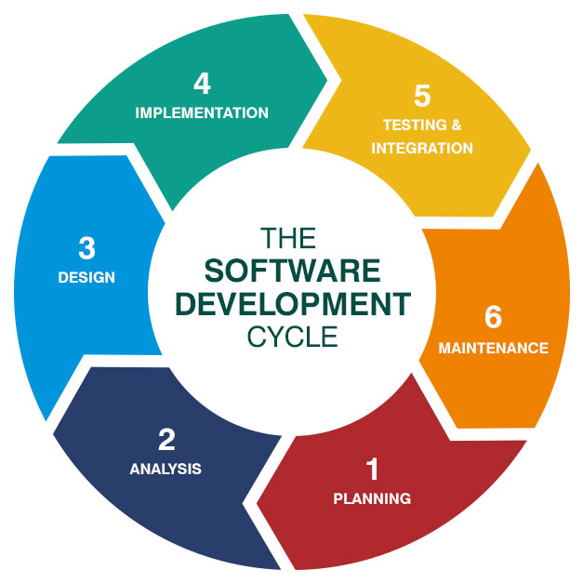
SOFTWARE DEVELOPMENT LIFECYCLE
1. Planning
Invision the Idea
2. Analysis
Collaborate with Stakeholders and gather information
3. Design
Start bringing in ideas and have a time frame planned
4. Implementation
The development really starts
5. Testing and Integration
Test if it works
6. Deployment
Test the completion of the product
7.Maintenance
Fix bugs and update it
Notes:
Getting Started: Instead of having a detailed plan by having Agile it makes you work on the product backlog. Its important because it makes you adapt and flexible to change
Planning the Sprint: At the beginning of each work period (sprint), the team picks tasks from the list to focus on.
Doing the Work: During the sprint, the team works on these chosen tasks, having quick meetings each day to stay on track.
Testing as You Go: Testing happens with the development, to make sure things work smooth. If there are any changes to the code it would be checked to make sure it works
Showing Progress: At the end of each sprint, the team shows what they've finished. It helps stakeholders see the progress and give feedback.
Learning and Improving: After each sprint, the team reflects on what went well and what could be better. They do this so they can improve

Slide 4
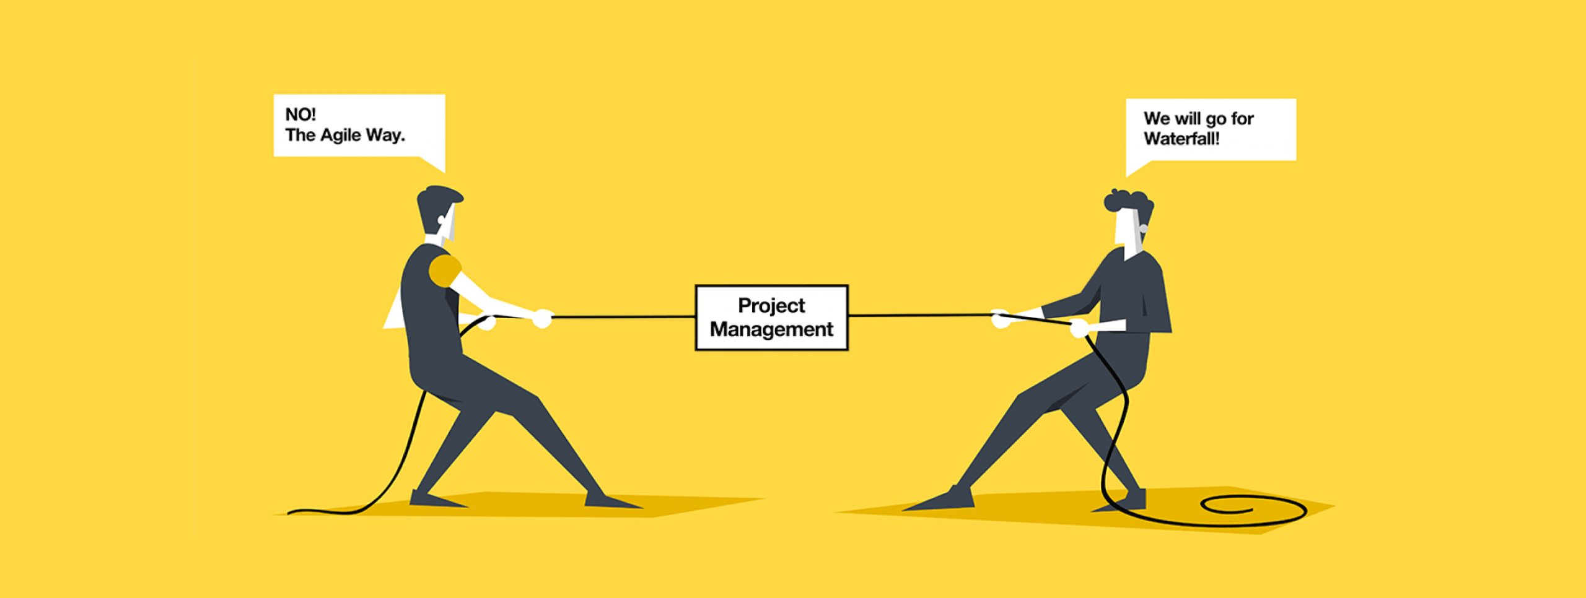
Agile Vs Waterfall
Agile
No really define requirements
Not linear
Able to adapt and change with no problem
Not deadline driven
Waterfall
Everything has to be defined
Has to be a linear path
Best if there are no changes to the project
Deadline driven
Notes:
By having a waterfall method everything needs to be planned way ahead of time, there is little to no errors since you are on a time crunch. It’s a linear path which may seem good but long term its not very good. By having an Agile method, you are able to adapt to change and at first nothing will be defined but when the project start to change, they will be things defined. One example comes to mind that the waterfall method will fail at. When the product owner needed to make a change of type of vacation with an agile method it was easy to make the changed but if you had a waterfall method you would have to scrap the project and start all over again and that is not feasible. That means the deadline would still be the same and moral for the team would be down since they have to redo everything in a waterfall method. If I had a team I would be using the Agile since it unpredictable and clients wants and needs always change. I would rather be in constant communication with the client and stakeholder letting them know what happens and deadlines have to be changed vs a waterfall method where its one deadline and if anything changes it’s a free for all.

Slide 5
References
Collins, Katie. “Waterfall vs Agile Development.” Fasthosts Blog, Fasthosts Blog, 27 Apr. 2022, www.fasthosts.co.uk/blog/waterfall-vs-agile-development/.
“The Agile Software Development Life Cycle: Wrike Agile Guide.” Versatile & Robust Project Management Software, www.wrike.com/agile-guide/agile-development-life-cycle/. Accessed 22 Feb. 2024.
“What Is the Software Development Life Cycle (SDLC) and How Does It Work?” Synopsys, www.synopsys.com/glossary/what-is-sdlc.html#:~:text=The%20Software%20Development%20Life%20Cycle%20(SDLC)%20is%20a%20structured%20process,all%20customer%20expectations%20and%20demands. Accessed 22 Feb. 2024.
Atlassian. “A Deep Dive into Scrum Team Roles.” Atlassian, www.atlassian.com/agile/scrum/roles. Accessed 22 Feb. 2024.

